Slide 1
Fall final exam review
2012

Slide 2
Problem 1
How many significant digits are in this measurements:
A. 0.00000320cm
B. 4.20cm
C. 5.00 x 10⁷cm
D. 439 000 cm

Slide 3
Solution:
A. 3
B. 3
C. 3
D. 3
If decimal is present read left to right; no counting until first non zero digit.
If NO decimal is present read right to left; no counting until first non zero digit.
In scientific notation; ignore the x10^{x}

Slide 4
problem 2
An element has an atomic number of 94 and a mass number of 210.
How many protons, neutrons and electrons are in a neutral atom of the element?

Slide 5
solution
A=P=E ; atomic number = protons= electrons
For every + = - so there is a neutral atom
M-A=N ; mass number – atomic number = neutrons
Atomic # = 94 210
P+ = 94 - 94_
e- = 94 116n⁰

Slide 6
Problem 3
What is the mass of a 250 mL sample of zinc with a density of 7.14 g/mL

Slide 7
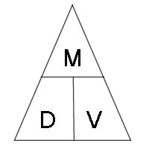
solution
(7.14)(250) = 1785 g = 1800g
*final answer can only have 2 sig figs

Slide 8
Problem 4
Name the element represented by the following
electron configuration: 1s²2s²2p⁶3s¹.

Slide 9
solution
Na sodium

Slide 10
Problem 5
Draw Lewis Dot Diagrams for each.
a. Sodium b. Calcium c. Nitrogen d. Sulfur

Slide 11
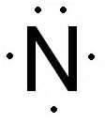
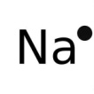
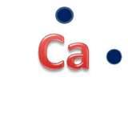
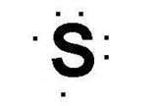
solution
Dots= valance electrons
Valance electrons = group #

Slide 12
Problem 6
A polar covalent bond is found in which molecule:
a. H₂ b. NaCl c. H₂O

Slide 13
solution
Water of course! Water is the most polar compound on earth!
Also:
a. H₂= diatomic; equal electro negativities
b. NaCl= ionic; transfer electrons m/nm combo
c. H₂O= bent shape

Slide 14
Problem 7
. Which one of the following is a pure substance and composed of only one substance?
a. sugar b. sugar water c. jolly ranchers

Slide 15
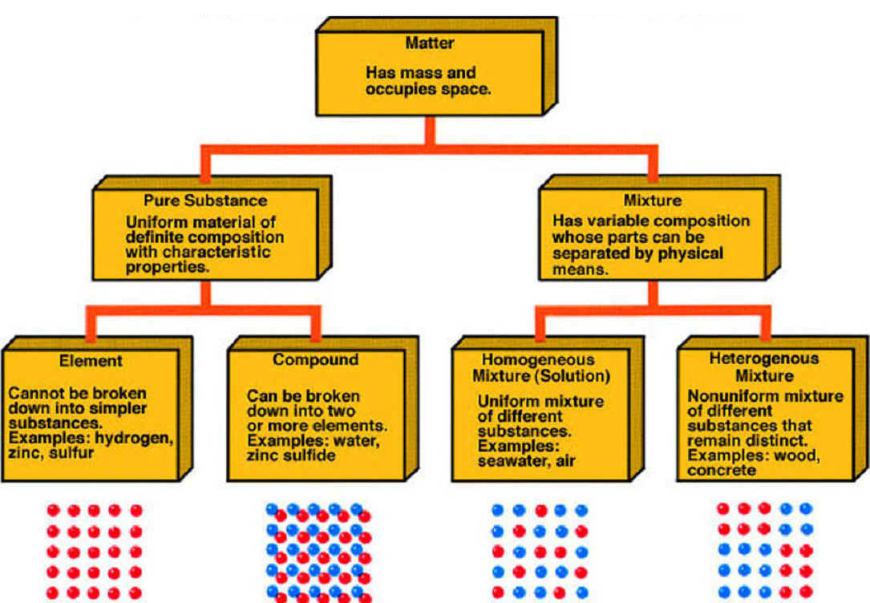
Solution sugar!!!

Slide 16
Problem 8
Which substance can be decomposed by a chemical change? NO, Ni, No

Slide 17
solution
NO is the answer because it is chemically bonded. The other two choices were just elements, so there is nothing to separate.

Slide 18
Problem 9 what does W represent?

Slide 19
Solution
Alkali family!

Slide 20
Problem 10
What is the formula for lead (II) fluoride?

Slide 21
Solution
PbF₂

