Slide 1
Frequency and Wavelength
Notes:
Objectives:
To explain the wave nature of light.
To state the relationship of wavelength, frequency, and energy of light.

Slide 2
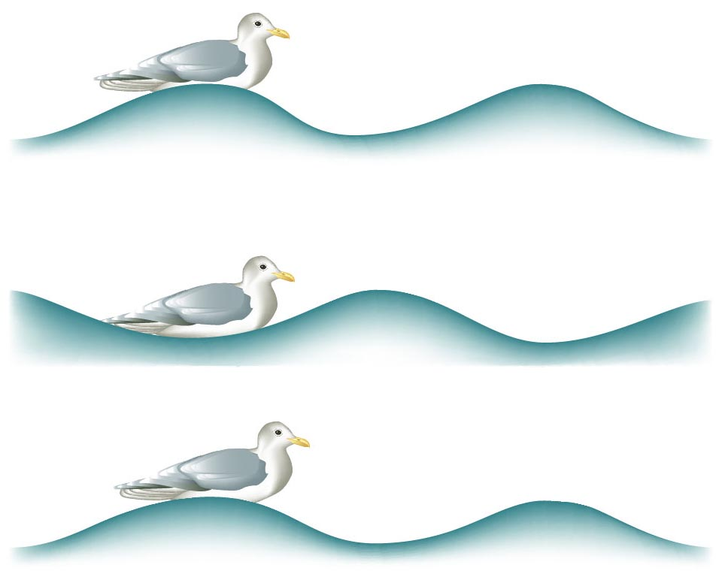
Waves on the Ocean
Zumdahl, Zumdahl, DeCoste, World of Chemistry 2002, page 324

Slide 3
Wavelength of a Wave
λ
Zumdahl, Zumdahl, DeCoste, World of Chemistry 2002, page 324

Slide 4
Wavelength of a Wave
λ
Zumdahl, Zumdahl, DeCoste, World of Chemistry 2002, page 324

Slide 5
Waves
Wavelength (λ) - length of one complete wave
Frequency (ν) - # of waves that pass a point during a certain time period
hertz (Hz) = 1/s
Amplitude (A) - distance from the origin to the trough or crest
f
Courtesy Christy Johannesson www.nisd.net/communicationsarts/pages/chem
Notes:
Wave — a periodic oscillation that transmits energy through space
Characteristic properties of waves
1. Waves are periodic.
– They repeat regularly in both space and time.
2. Wavelength
– Distance between two corresponding points in a wave
– Symbolized by λ
– Described by any appropriate unit of distance
3. Frequency of a wave
– Number of oscillations that pass a particular point in a given period of time
– Represented by the symbol ν
– Units are oscillations per second or 1/s = s⁻¹, which is called the hertz (Hz)
4. Amplitude, or vertical height, of a wave
– Defined as half the peak-to-trough height
– As the amplitude of a wave with a given frequency increases, so does its energy
– Two waves can have the same amplitude but different wavelengths
5. Speed
– Distance traveled by a wave per unit of time
– Represented by the symbol υ
– Measured in meters per second (m/s)
– Speed of a wave is equal to the product of its wavelength and frequency
(wavelength) (frequency) = speed
λν = υ
(meters) (waves) = meters
(waves) (second) second

Slide 6
Waves
λ
crest
A
greater amplitude
(intensity)
origin
A
trough
λ
greater frequency
(color)
Courtesy Christy Johannesson www.nisd.net/communicationsarts/pages/chem

Slide 7
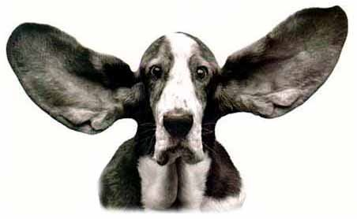
Frequency
1 second
Frequency
4 cycles/second = 4 hertz
12 cycles/second = 12 hertz
36 cycles/second = 36 hertz
O’Connor, Davis, MacNab, McClellan, CHEMISTRY Experiments and Principles 1982, page 166
Notes:
The energy of light is closely related to its color. High energy light appears purple, low energy light appears red, and intermediate energies of light have intermediate colors such as blue, green, yellow, and orange.
Higher frequency waves have more energy and are of a shorter wavelength.
In visible light, red light has the longest wavelength (lowest frequency) and blue/violet light has the shortest wavelength (highest frequency).
http://www.softwarereality.com/soapbox/images/DogEars.jpg

Slide 8
Waves
long wavelength λ
Amplitude
Low
frequency
short wavelength λ
Amplitude
High
frequency

Slide 9
Waves
long wavelength λ
Amplitude
Low
frequency
60 photons
low energy
short wavelength λ
Amplitude
High
frequency
162 photons
high energy
Notes:
Einstein‘s photons of light were individual packets of energy that had many characteristics of particles.
• Einstein’s hypothesis that energy is concentrated in localized bundles was in sharp contrast to the classical notion that energy is spread out uniformly in a wave.

