Slide 1
Naming Ions, Compounds, and Acids

Slide 2
essential question:
what is an ionic compound?
how is an ionic compound formed?
how are ionic compounds named?

Slide 3
what is an ionic compound?
ionic compound-
transfer of an electron
An ionic compound has no overall charge

Slide 4
how is an ionic compound formed?
a metal cation donates an electron
a non-metal anion receives an electron
cations have a positive charge &
anions have a negative charge
the sum of the cation and anion charges add up to zero. The overall charge of an ionic compound is zero.

Slide 5
ppt notes question
1. what is the difference between a binary NaCl and ternary compound NaCO₃?

Slide 6
ppt notes question
1. what is the difference between a binary and ternary compound?
A binary compound has two elements, and a ternary compound has more than two elements.

Slide 7
ppt notes question
2. What is the difference between a monoatomic and a polyatomic ion?

Slide 8
ppt notes question
2. What is the difference between a monoatomic and a polyatomic ion?
A monoatomic ion has one element, and a polyatomic ion has more than one element.

Slide 9
how is an ionic compound formed?
A compound is a pure substance that cannot be broken down into its elements using physical methods.
A cation and an anion chemically bond together to form an ionic compound.
The sum of the charge of the cation and the anion is zero.
Notes:
physical methods include filtering, using a sieve, crystallization, or other methods without chemicals

Slide 10
how is an ionic compound formed?
A cation is a metal with a positive charge. Cations are listed first in a formula.
NaCl
Sodium is Na, an alkali metal in group 1.

Slide 11
how is an ionic compound formed?
An anion is a non-metal with a negative charge. Anions are listed second in a formula.
NaCl
Chlorine is Cl, a halogen in group 17.

Slide 12
ppt notes question
3. write a brief statement of how to write the name of a binary ionic compound

Slide 13
ppt notes question
3. write a brief statement of how to write the name of a binary ionic compound
A cation (metal) is listed first and an anion (non-metal) is listed second in the formula and in the name

Slide 14
how is an ionic compound formed?
The charge of the cation and the charge of the anion add to zero.
the overall charge of an ionic compound is zero.
charges can be:
fixed
variable

Slide 15
how is an ionic compound formed?
fixed charges- a charge that is always the same. All representative elements have fixed charges.
variable charges- some elements can have more than one charge, depending on the “oxidation” of the metal. Many transition metals have variable charges.

Slide 16
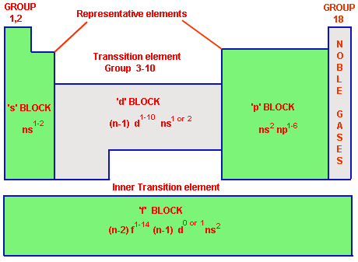
how is an ionic compound formed?
Where are the representative elements and transition
elements?
Notes:
image http://chemistry.tutorvista.com/inorganic-chemistry/representative-elements.html

Slide 17
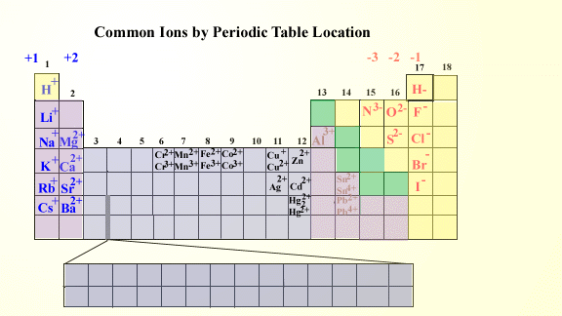
how is an ionic compound formed?
Please label the charges at the top of each group on your periodic table in your notebook:
+1 +2
+3 -3 -2 -1
Notes:
image http://www.shodor.org/os411/courses/411a/module02/unit02/page03.html

Slide 18
ppt notes question
4. write a brief statement of how to write the name of a binary ionic compound that contains a metal with a variable oxidation number (charges)

Slide 19
ppt notes question
4. write a brief statement of how to write the name of a binary ionic compound that contains a metal with a variable oxidation number (charges)
For transition metals, use a roman numeral to name the oxidation state (charge of the metal)

Slide 20
ppt notes question
4. read over the symbol examples with their charges
Na⁺ ^{sodium} | Mg²⁺ ^{magnesium} |  | N³⁻ ^{nitrogen} | O²⁻ ^{oxygen} | F⁻ ^{fluorine}
K⁺ ^{potassium} | Ca²⁺ ^{calcium} | Al³⁺ ^{aluminum} | P³⁻ ^{phosphorus} | S²⁻ ^{sulfur} | Cl⁻ ^{chlorine}

Slide 21
ppt notes question
4. read over the symbol examples with their charges
Fe²⁺ ^{iron (II)} | Fe³⁺ ^{iron (III)} | Cu¹⁺ ^{copper (I)} | Cu²⁺ ^{copper (II)} | Pb²⁺ ^{lead (II)} | Pb⁴⁺ ^{lead (IV)}

Slide 22
ppt notes question
6. look at the examples. What is the formula for strontium fluoride?
copper (I) sulfide?
lead (IV) oxide?

Slide 23
ppt notes question
6. look at the examples. What is the formula for strontium fluoride? SrF₂
copper (I) sulfide? Cu₂S
lead (IV) oxide? Pb₂O₄ then PbO₂
divide both subscripts by 2
(subscript tells the number of the atoms in a compound)

Slide 24
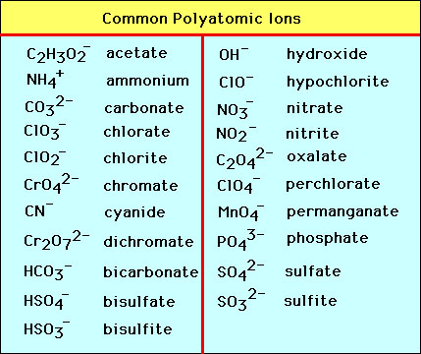
ppt notes question
7. read over the polyatomic ion list. You do not need to
memorize
these!
Notes:
image http://www.iun.edu/~cpanhd/C101webnotes/chemical-nomenclature/polyatomsalts.html

Slide 25
ppt notes question
8. look at the ternary ionic compound examples. when do you need to use parenthesis?
Mg(OH)₂ | (NH₃)₂SO₄
Pb(CO₃)₂ | Ca(ClO₃)₂

Slide 26
ppt notes question
8. look at the ternary ionic compound examples. when do you need to use parenthesis?
The parenthesis are used when more than one polyatomic ion (cation or anion) is in the ionic compound.

Slide 27
ppt notes question
9. what is the total number of atoms in Al₂(SO₄)₃
how many aluminum atoms?
how many oxygen atoms?
how many sulfur atoms?
how many atoms total?

Slide 28
ppt notes question
9. what is the total number of atoms in Al₂(SO₄)₃
how many aluminum atoms? 2
how many oxygen atoms? 12
how many sulfur atoms? 3
how many atoms total? 12+3+2= 17 atoms

Slide 29
ppt notes question
10. read over the examples. what is the formula for
calcium phosphate?
ammonium carbonate?
copper (II) hydroxide?

Slide 30
ppt notes question
10. read over the examples. what is the formula for
calcium phosphate? Ca₃(PO₄)₂
ammonium carbonate? (NH₃)₂CO₃
copper (II) hydroxide? Cu(OH)₂

Slide 31
how are ionic compounds named?
representative metals do not use a roman numeral
transition metals use a roman numeral
cations (metals) are listed first and anions (non-metals) are listed second
monoatomic anions are the element name plus -ide ending

Slide 32
POP QUIZ!
ANSWER THE FOLLOWING:
2. write the compound: Mg²⁺ PO₄³⁻
5. write the name: Ni₂S₃
7. write the name: PbO
9. total number of atoms: CH₃C₆H₂(NO₂)₃

Slide 33
POP QUIZ!
ANSWER THE FOLLOWING:
2. write the compound: Mg²⁺ PO₄³⁻
Magnesium phosphate
5. write the name: Ni₂S₃ nickel (III) sulfate
7. write the name: PbO lead (II) oxide
9. total number of atoms: CH₃C₆H₂(NO₂)₃ 1+3+6+2+3+6= 21 atoms

Slide 34
part II
Covalent Compounds
and
Acids

Slide 35
essential questions
what are covalent compounds?
how are covalent compounds formed?
how are covalent compounds named?
how are acids named?

Slide 36
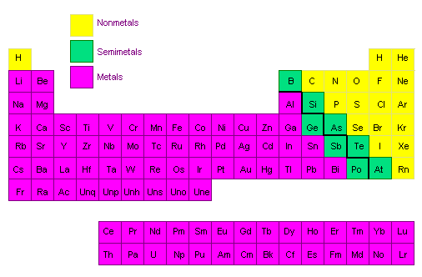
what are covalent compounds?
covalent compounds-
share electrons
organic compounds (carbon based)
non-metal bonded
to another non-metal

Slide 37
ppt notes question
12. what type of elements compose covalent compounds? are oxidation numbers needed? how do you use the prefix?
1 | 2 | 3 | 4 | 5 | 6 | 7
mono- | di- | tri- | tetra- | penta- | hexa- | hepta-

Slide 38
ppt notes question
12. what type of elements compose covalent compounds? are oxidation numbers needed? how do you use the prefix?
Two nonmetals bond to form a covalent bond. Oxidation numbers are not used. Prefixes show the number of each element. Mono- is not used for the first non-metal in the compound.

Slide 39
ppt notes question
13. what is the prefix for four?
for seven?

Slide 40
ppt notes question
13. what is the prefix for four? tetra-
for seven? hepta-

Slide 41
ppt notes question
14. what is the formula for diarsenic trisulfide?
what is the name of N₂O₅

Slide 42
ppt notes question
14. what is the formula for diarsenic trisulfide?
As₂S₃
what is the name of N₂O₅
dinitrogen pentoxide

Slide 43
ppt notes question
15. acid names are derived from the anion that is bonded to hydrogen.
Formula
If the anion name is…
The acid formed from this anion is named…
HCl
chloride
hydrochloric acid
HClO
hypochlorite
hypochlorous acid
HClO₂
chlorite
chlorous acid
HClO₃
chlorate
chloric acid
HClO₄
perchlorate
perchloric acid

Slide 44
ppt notes question
15. acid names are derived from the anion that is bonded to hydrogen.
-ide ending names change their ending to -ic
-ite ending names change their ending to -ous
-ate ending names change their ending to -ic

Slide 45
ppt notes question
16. what do all of the acids start with?
if an acid does not contain oxygen and has an one element anion, what prefix is included in its name?
HCl | HBr | HF
hydrochloric acid | hydrobromic acid | hydrofluoric acid

Slide 46
ppt notes question
16. what do all of the acids start with? hydrogen
if an acid does not contain oxygen and has an one element anion, what prefix is included in its name?
hydro- is the prefix.
HCl | HBr | HF
hydrochloric acid | hydrobromic acid | hydrofluoric acid

Slide 47
please study the ppt notes and the homework assignment. Next class is an open notebook quiz over this material.

