Slide 1
Nuclear Energy

Slide 2
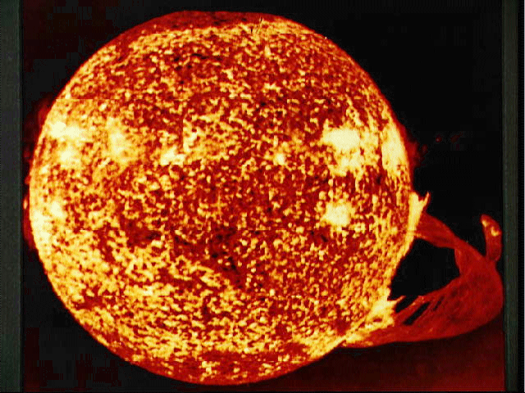
Fission vs. Fusion
Different
Alike
Different
Change
Nucleus
of
Atoms
Split
large atoms
U-235
Fuse small atoms
2H₂ He
Topic
Topic
Radioactive
waste
(long half-life)
Create
Large Amounts
of Energy
E = mc²
NO
Radioactive
waste
Fusion
Fission
Nuclear
Power
Plants
Transmutation
of Elements
Occurs
Very High
Temperatures
~5,000,000 ºC
(SUN)

Slide 3
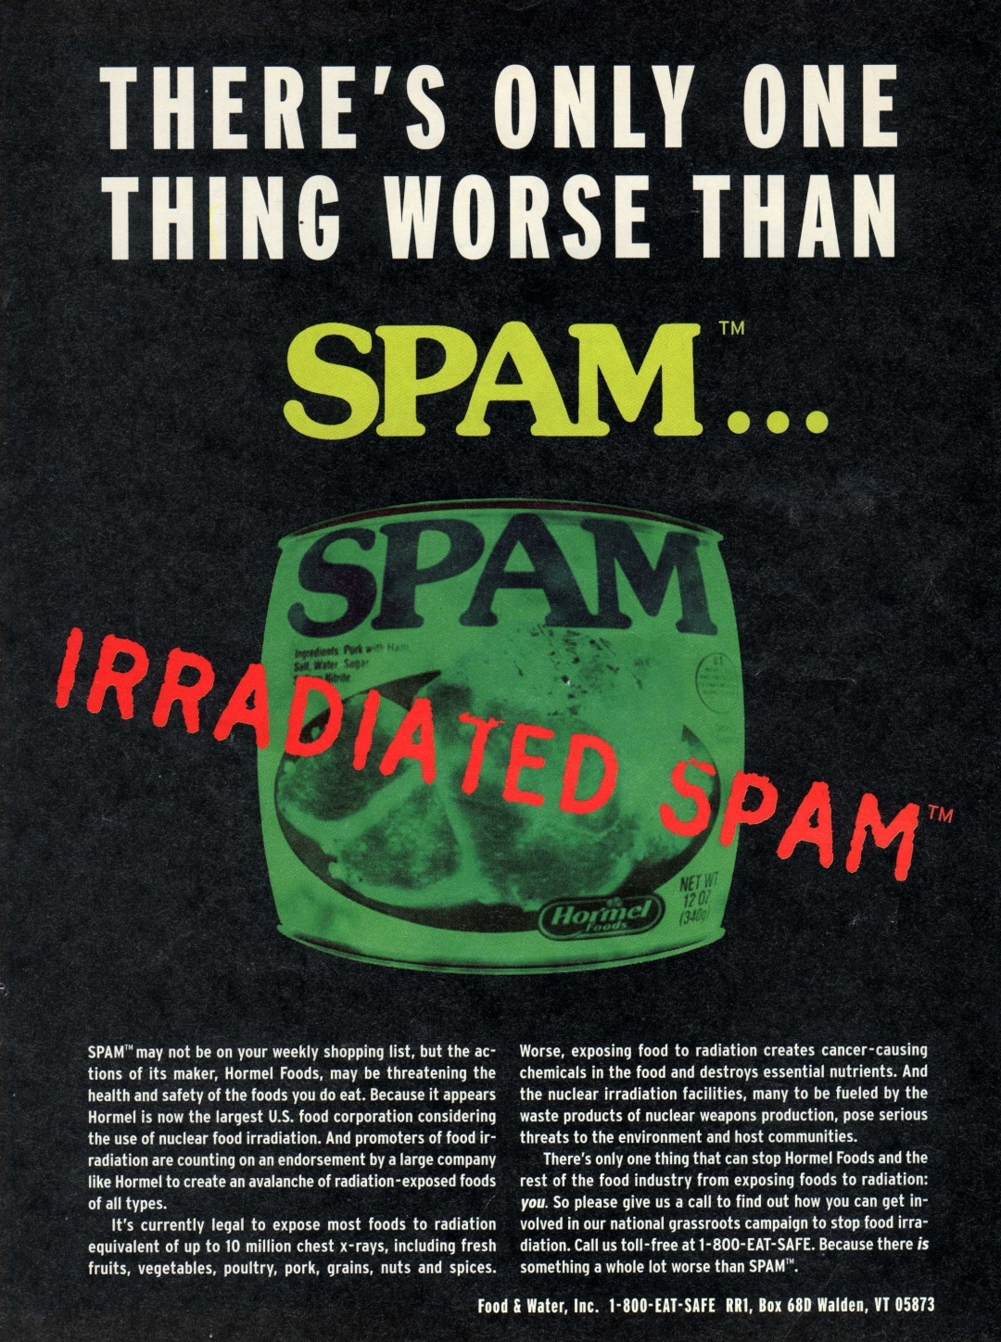
Irradiated Spam
Irradiated SPAM
Use fear and selective facts
to promote an agenda
Eating animals?
Radiation = Bad
Look who is funding research;
it may bias the results.

Slide 4
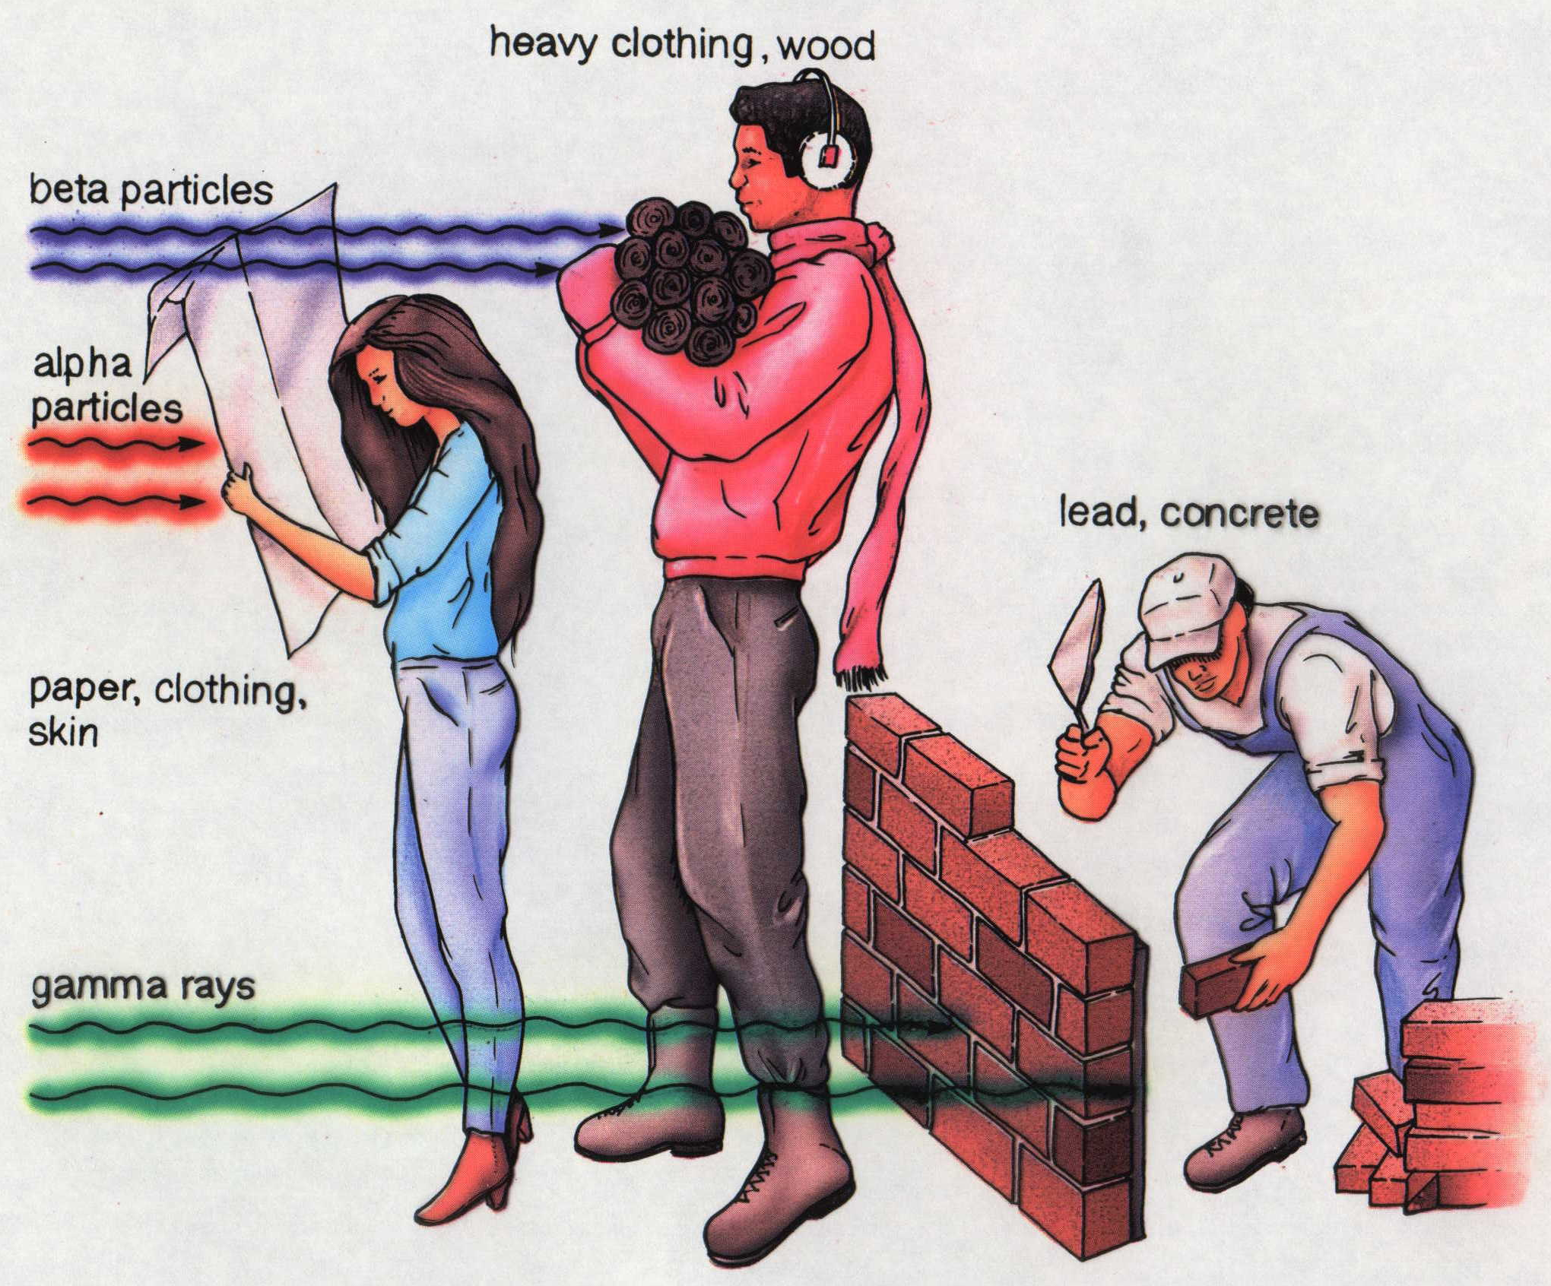
Shielding Radiation
Notes:
Which type of radiation is the most penetrating? gamma rays
Which type of radiation do you think is most dangerous? gamma rays
Sun glasses have UVA and UVB protection.
The UV-A stand for ultra violet alpha particles and the UV-B stands for ultra violet beta particles.
Almost all sunglasses offer 100% UVA protection. Be sure to get 100% UVB protection as well.

Slide 5
Nuclear Fission
First stage: 1 fission
Second stage: 2 fission
Third stage: 4 fission
Notes:
Fission is the splitting of larger atoms into smaller atoms. This is done by bombardment of a neutron to create an unstable nucleus.
An unwanted effect of fission is nuclear radiation.
Nuclear power plants use nuclear fission to produce energy.

Slide 6
Nuclear Fission

Slide 7
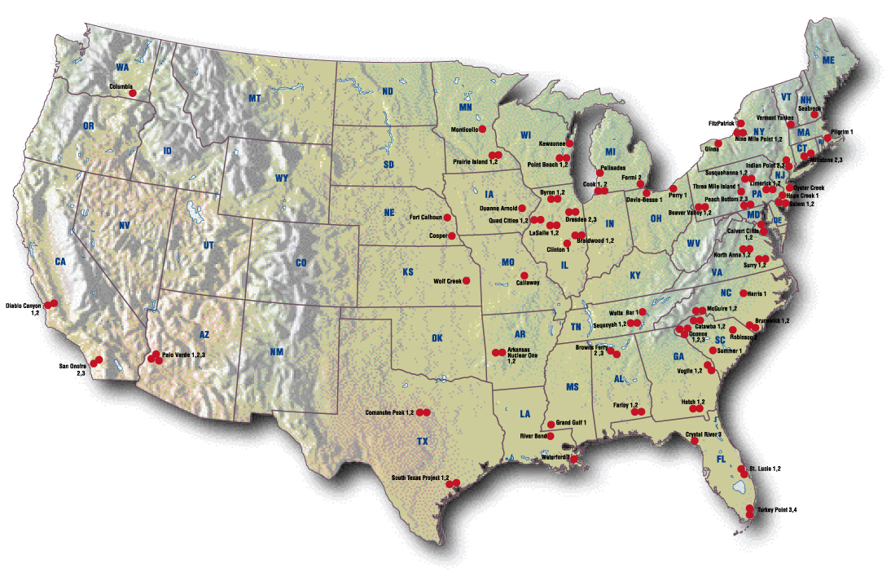
Nuclear Power Plants
map: Nuclear Energy Institute
Notes:
http://www.uic.com.au/graphics/US%20Nuclear%20map.jpg

Slide 8
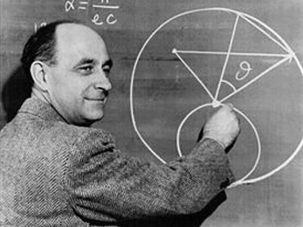
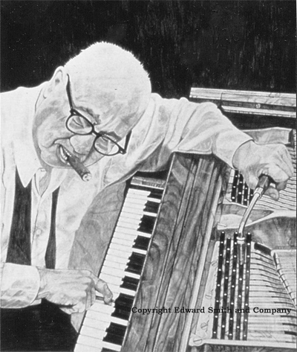
Fermi Approximations
FERMI APPROXIMATIONS
An educated guess – based on a series
of calculations of known facts – to arrive
at a reasonable answer to a question.
Enrico Fermi
How many piano tuners are
there in New York City?
ANSWER:
400 piano tuners
Notes:
Enrico Fermi worked on the Manhattan project. He was a physicist and had to determine if developing an atomic bomb would set off a fission chain reaction in the atmosphere that would destroy the Earth's atmosphere. He determined this would not happen, by making reasonable calculations (these we call Fermi type calculations).
You can’t just look up the answer to this on Google or look for ads in the yellow pages. All piano tuners will not be listed. We must solve this problem using a series or approximations to arrive at the final answer.
Assume population of NYC is 20 million people.
Each family has ~4 people. Therefore, 5 million families.
Take a poll in classroom to get percentage of families with a piano. [Assume 1 out of 5 families have piano]
Now you are left with 1,000,000 pianos to tune.
Each piano should be tuned every 6 months…but realistically they are tuned every two years!
This means 500,000 pianos should be tuned annually in NYC.
A piano tuner can tune 5 pianos each day. This means we have 100,000 days of work per year.
Each tuner works about 250 days per year.
Therefore, 400 piano tuners would be a good Fermi approximation for the number of piano tuners in New York City.

Slide 9
Nuclear Fusion
Sun
+
+
+
Energy
Four
hydrogen
nuclei
(protons)
Two beta
particles
(electrons)
One
helium
nucleus

Slide 10
Conservation of Mass
…mass is converted into energy
Hydrogen (H₂) H = 1.008 amu
Helium (He) He = 4.004 amu
FUSION
2 H₂ → 1 He + ENERGY
1.008 amu
x 4
4.0032 amu = 4.004 amu + 0.028 amu
This relationship was discovered by Albert Einstein
E = mc²
Energy= (mass) (speed of light)²

Slide 11
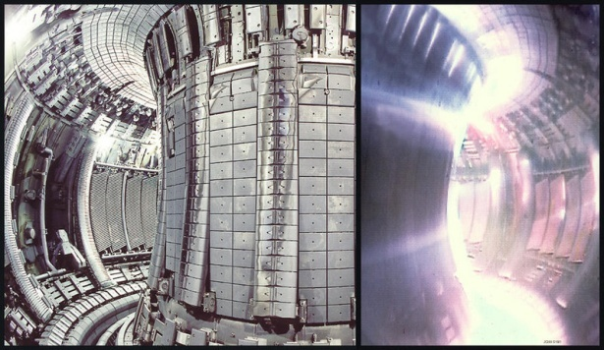
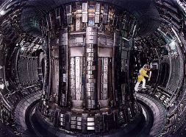
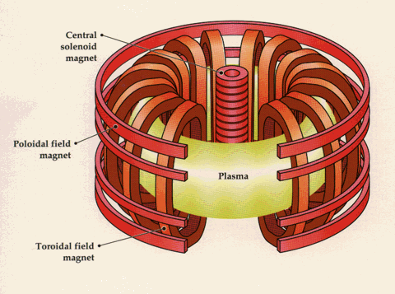
Tokamak Reactor
Fusion reactor
10,000,000 º Celcius
Russian for torroidial (doughnut shaped) ring
Magnetic field contains plasma
Notes:
http://www.anthonares.net/JET_tokamak.jpg

Slide 12
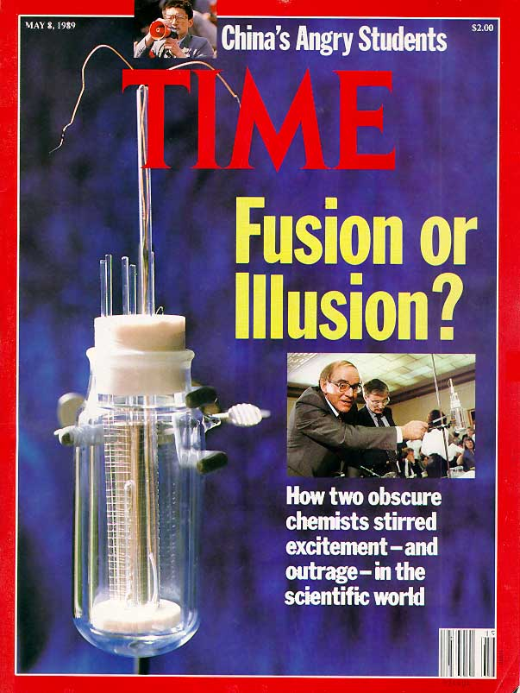
Cold Fusion?
Fraud?
Experiments must
be repeatable to
be valid
Notes:
Stanley Pons and Martin Fleischman reported having developed cold fusion.
No one else could verify their results. Both men lost a great deal of scientific credibility.
Image: cover of TIME magazine May 8, 1989.

Slide 13
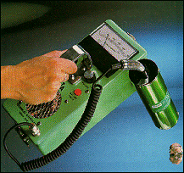
Half-life of Radiation
Initial amount
of radioisotope
100
After 1 half-life
After 2 half-lives
Radioisotope remaining (%)
50
After 3 half-lives
t_{1/2}
25
t_{1/2}
12.5
t_{1/2}
0 1 2 3 4
Number of half-lives

