Slide 1
Buy this as a periodic table poster!

Slide 2
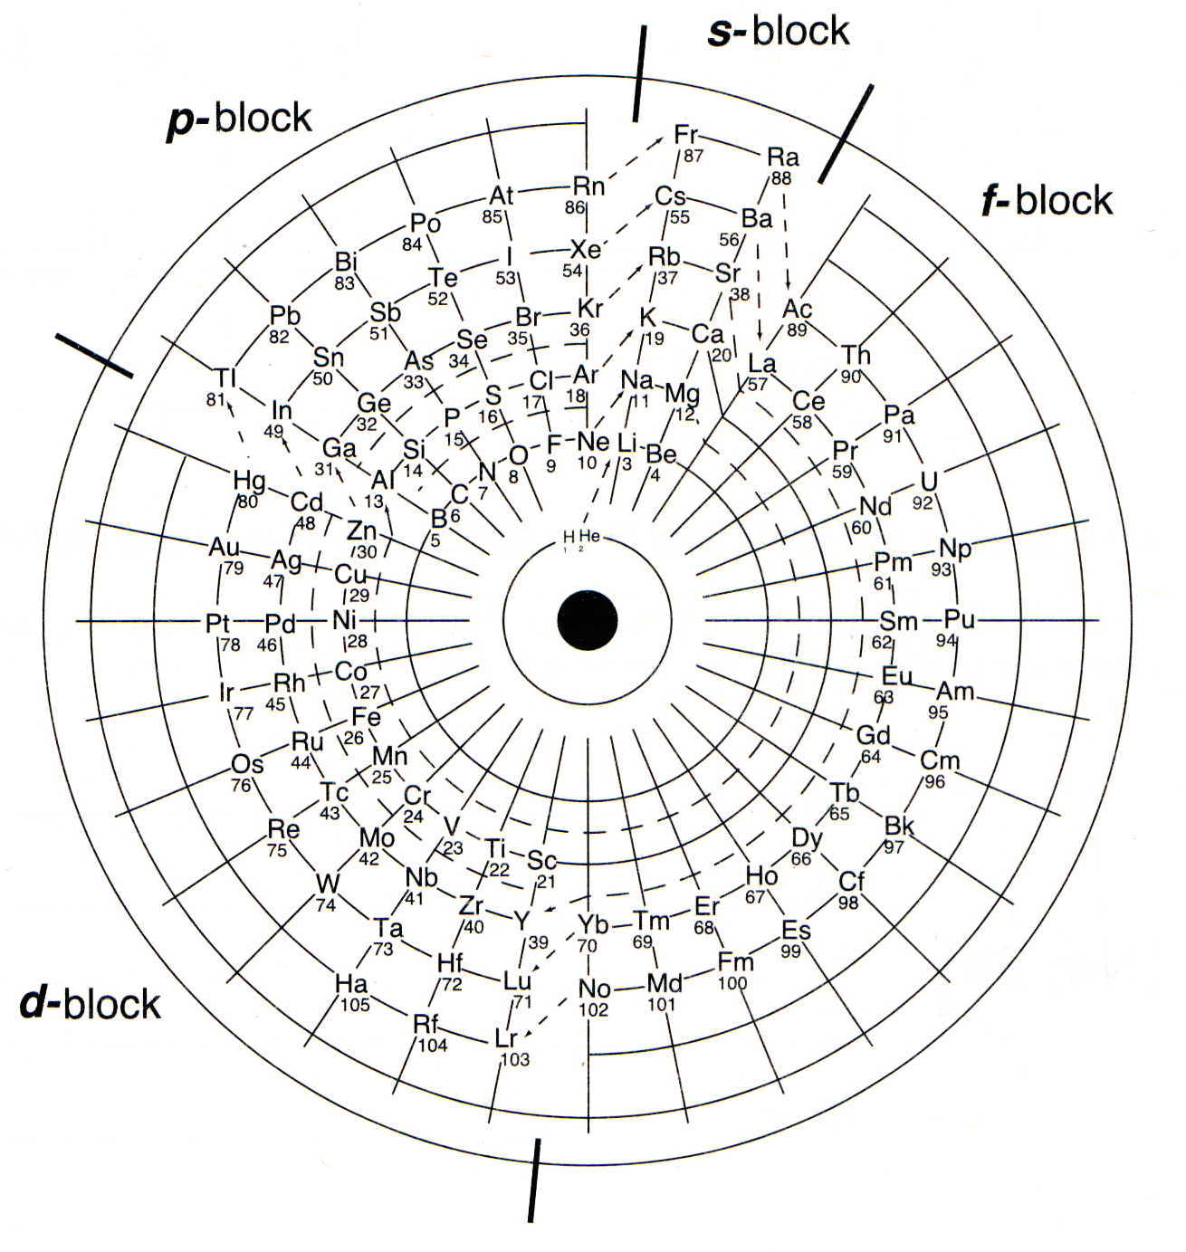
Dutch Periodic Table
117
118
116
115
114
113
112
111
110
109
108
107
106
Strong, Journal of Chemical Education, Sept. 1989, page 743

Slide 3
Stowe’s Periodic Table

Slide 4
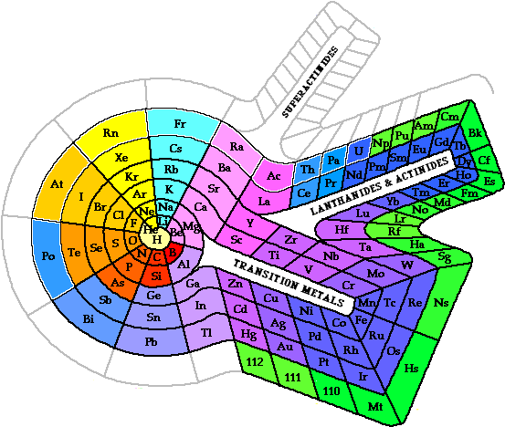
Benfey’s Periodic Table

Slide 5
Origin of the Names of Elements
Title Number of Elements
Pre-chemical Names 10
Names from celestial bodies 8
Names from mythology / superstition 10
Names from minerals / ores,
other than geographical names 13
Names from colors 9
Names from properties other than color 8
Geographical names from the domicile or
workplace of the discoverer(s) 13
Geographical names from minerals / ores 10
Constructed names 16
Names from persons 10
Ringnes, Journal of Chemical Education, Sept. 1989, page 731
Notes:
Graphic from: http://www.science-house.org/learn/astro/origins.JPG

Slide 6
Diatomic Molecules
Distance
between
nuclei
Hydrogen (H₂)
atomic radius = 37 pm
Chlorine (Cl₂)
atomic radius = 99 pm
Nucleus
Fluorine (F₂)
atomic radius = 64 pm
Bromine (Br₂)
atomic radius = 114 pm
Oxygen (O₂)
atomic radius = 66 pm
Atomic
radius
Nitrogen (N₂)
atomic radius = 71 pm
Iodine (I₂)
atomic radius = 138 pm
HOBrFINCl twins
H₂ O₂ Br₂ F₂ I₂ N₂ Cl₂

Slide 8
Periodic Trends

Slide 9
Attraction and Repulsion of Electrical Charges
+
-
+
+
-
-
Particles with opposite
charges attract
one another.
Particles with like charges
repel one another.

Slide 10
Coulombic Attraction
A
1+
1-
4-
3-
D
2+
2-
B
Coulombic Attraction
1) Charge
opposites attract
like repels
2) Distance
2+
2-
C

Slide 11
Shielding Effect
Valence
+
-
nucleus
-
-
Electrons
-
Electron
Shield
“kernel”
electrons
Kernel electrons block the attractive force of the nucleus from the valence electrons
Notes:
Some schools use the term “screening” as I use the term “shielding”.

Slide 12
Shielding Effect and Effective Nuclear Charge
12
Mg
24.305
attractions
repulsions
+
_
_
_
Mg = [Ne]3s²
Hill, Petrucci, General Chemistry An Integrated Approach 2nd Edition, page 336
Notes:
"The simplified sketch of a magnesium atom shows the two valence electrons as discrete particles.
The remaining 9 core electrons are shown as a circular cloud of negative electric charge.
Interactions between valence electrons, core electrons, and the atomic nucleus determine an
effective nuclear charge. Attractions are indicated in red and repulsion in blue.“
For an atom or ion that has only a single electron, the potential energy can be calculated by considering only the electrostatic attraction between the positively charged nucleus and the negatively charged electron.
When more than one electron is present, the total energy of the atom or ion depends not only on the attractive electron-nucleus interactions but also on repulsive electron-electron interactions.
One must use approximate methods to deal with the effect of electron-electron repulsions on orbital energies
If an electron is far from the nucleus, then at any given moment, most of the other electrons will be between that electron and the nucleus.
The electrons will cancel a portion of the positive charge of the nucleus and will decrease the attractive interaction between it and the electron farther away.
Electrons farther away experiences an effective nuclear charge, Z_{eff}. that is less than the actual nuclear charge Z (an effect called electron shielding).

Slide 13
Decreasing Atomic Size Across a Period
As the attraction between the (+) nucleus and the (–) valence electrons ↑, the atomic size ↓. Greater coulombic attraction.
From left to right, size decreases because there is an increase in nuclear charge and Effective Nuclear Charge (# protons – # core electrons).
Each valence electron is pulled by the full ENC
Li
Be
B
1s²2s¹
1s²2s²
1s²2s²2p¹
(ENC = 1)
(ENC = 2)
(ENC = 3)
Li
Be
B
+
+
+
+
+
+
+
+
+
+
+
+

Slide 14
Atomic Radius

Slide 15
Atomic Radii
IA IIA IIIA IVA VA VIA VIIA
Li
Be
B
C
N
O
F
1.52 1.11
0.88 0.77 0.70 0.66 0.64
Na
Mg
Al
Si
P
S
Cl
1.86 1.60
1.43 1.17 1.10 1.04 0.99
K
Ca
Ga
Ge
As
Se
Br
2.31 1.97
1.22 1.22 1.21 1.17 1.14
Rb
Sr
In
Sn
Sb
Te
I
2.44 2.15
1.62 1.40 1.41 1.37 1.33
Cs
Ba
Tl
Pb
Bi
2.62 2.17
1.71 1.75 1.46
= 1 Angstrom
Notes:
Difficult to measure the dimensions of an individual atom
Distances between the nuclei in pairs of covalently bonded atoms can be measured and are used as a basis for describing the approximate sizes of atoms
Covalent atomic radius is half the internuclear distance in a molecule that contains two identical atoms bonded to each other, can be determined for most of the nonmetals
For metals, the metallic atomic radius is defined as half the distance between the nuclei of two adjacent metal atoms
For elements such as the noble gases, most of which form no stable compounds, van der Waals atomic radius is used and is half the internuclear distance between two nonbonded atoms in the solid
Atomic size seems to vary in a periodic fashion.
• In the periodic table, atomic radii decrease from left to right across a row because of the increase in effective nuclear charge due to poor electron screening by other electrons in the same principal shell. Atomic radii increase from top to bottom down a column because the effective nuclear charge remains constant as the principal quantum number increases.
• The largest atoms are found in the lower-left corner of the periodic table and the smallest in the upper-right corner.

Slide 16
0.3
Cs
Rb
0.25
K
0.2
Na
3d
transition
series
4d
transition
series
atomic radius
Li
La
0.15
Zn
Xe
0.1
Kr
Cl
F
0.05
He
H
0
0 10 20 30 40 50 60
atomic number

Slide 17
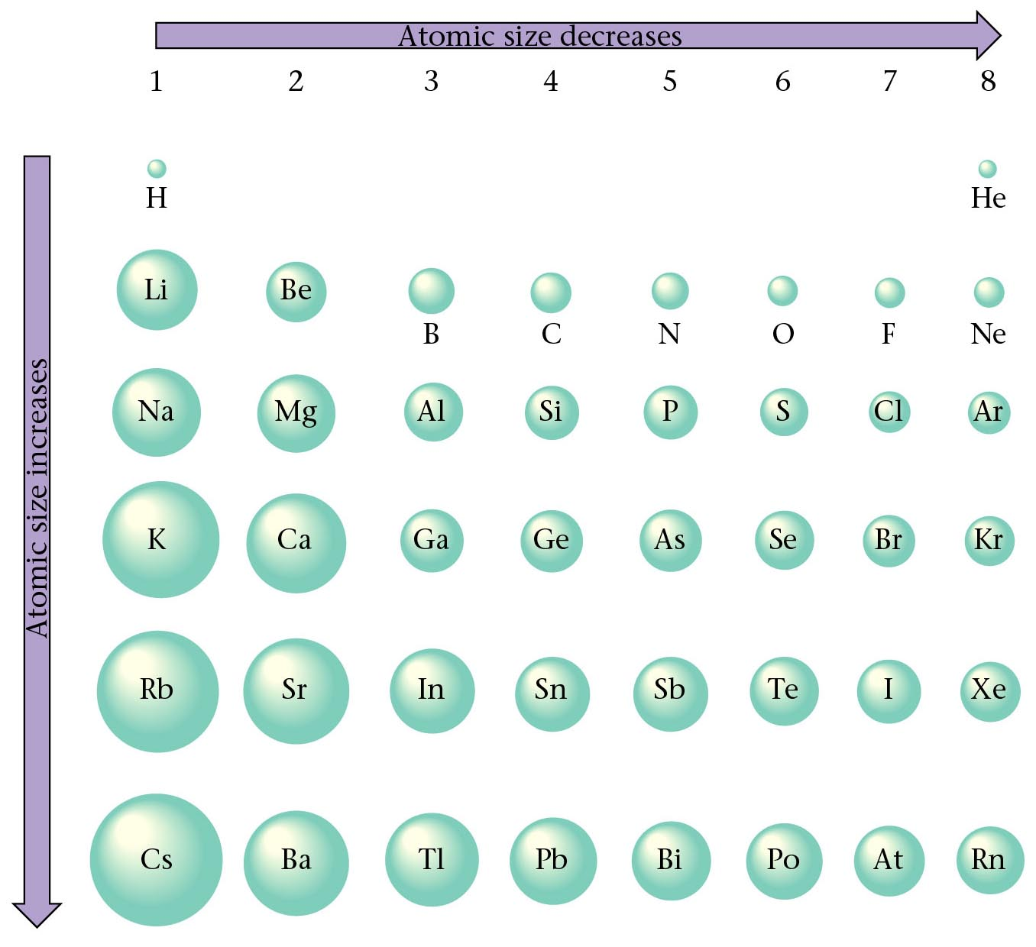
Relative Size of Atoms
Zumdahl, Zumdahl, DeCoste, World of Chemistry 2002, page 350

Slide 18
Ionic Radius

Slide 19
e
Li
Li⁺
152
60
Energy
e
Li
e
e
Li⁺
Li
Li
⁺
e
Lithium ion
60
152
152
Lithium atom
Lithium atom

Slide 20
Ionic Size
Cations form by losing electrons.
Cations are smaller that the atom they come from.
Metals form cations.
Cations of representative elements have noble gas configuration.

Slide 21
Formation of Cation
sodium atom
Na
sodium ion
Na⁺
e⁻
e⁻
e⁻
e⁻
e⁻
e⁻
e⁻
e⁻
e⁻
loss of
one valence
electron
11p⁺
e⁻
11p⁺
e⁻
e⁻
e⁻
e⁻
e⁻
e⁻
e⁻
e⁻
e⁻
e⁻
e⁻
e⁻

Slide 22
Ionic size
Anions form by gaining electrons.
Anions are bigger that the atom they come from.
Nonmetals form anions.
Anions of representative elements have noble gas configuration.

Slide 23
Formation of Anion
chlorine atom
Cl
chloride ion
Cl¹⁻
gain of
one valence
electron
e⁻
e⁻
e⁻
e⁻
e⁻
e⁻
e⁻
e⁻
e⁻
e⁻
e⁻
e⁻
e⁻
e⁻
e⁻
17p⁺
e⁻
17p⁺
e⁻
e⁻
e⁻
e⁻
e⁻
e⁻
e⁻
e⁻
e⁻
e⁻
e⁻
e⁻
e⁻
e⁻
e⁻
e⁻
e⁻
e⁻
e⁻
e⁻

Slide 24
Sizes of ions: electron repulsion
Valence electrons repel each other.
When an atom becomes a anion (adds an electron to its valence shell) the repulsion between valence electrons increases without changing ENC
Thus, F– is larger than F
9 +
-
-
-
-
-
-
-
-
9+
+1e⁻
-
9+
-
-
-
-
-
-
-
-
-
-
Fluorine atom
F
1s²2s²2p⁵
F¹⁻
1s²2s²2p⁶
Fluorine ion
Fluoride ion
Notes:
.

Slide 25
Atomic Radii
Ionic Radii
IA IIA IIIA IVA VA VIA VIIA
IA IIA IIIA IVA VA VIA VIIA
Li¹⁺
Be²⁺
N³⁻
Li
Be
O²⁻
F¹⁻
B
C
N
O
F
1.52 1.11
0.88 0.77 0.70 0.66 0.64
0.60 0.31
1.71 1.40 1.36
Na
Na¹⁺
Mg²⁺
Al³⁺
S²⁻
Cl¹⁻
Mg
Al
Si
P
S
Cl
1.86 1.60
1.43 1.17 1.10 1.04 0.99
0.95 0.65
0.50 1.84 1.81
K
Ca
Ge
As
Se²⁻
Br¹⁻
Ga
Se
Br
K¹⁺
Ca²⁺
Ga³⁺
2.31 1.97
1.22 1.22 1.21 1.17 1.14
1.33 0.99
0.62 1.98 1.85
Rb
Sr
Te²⁻
I¹⁻
In
In³⁺
Sn
Sb
Te
I
Rb¹⁺
Sr²⁺
2.44 2.15
1.62 1.40 1.41 1.37 1.33
1.48 1.13
0.81 2.21 2.16
Cs
Ba
Tl
Pb
Cs¹⁺
Ba²⁺
Tl³⁺
Bi
2.62 2.17
1.71 1.75 1.46
= 1 Angstrom
1.69 1.35
0.95
= 1 Angstrom

Slide 26
Trends in Atomic and Ionic Size
Metals
Nonmetals
Group 1
Group 13
Group 17
e
e
Li
Li⁺
F⁻
F
152
60
64
e
136
e
e
e
e
Na
Na+
Al
Al³⁺
Cl⁻
Cl
95
143
50
99
186
181
e
e
K
K+
Br⁻
Br
133
114
227
195
Cations are smaller than parent atoms
Anions are larger than parent atoms

Slide 27
IA IIA IIIA IVA VA VIA VIIA
Be
B
C
N
O
F
Li
Atomic
Radii
1.52 1.11
0.88 0.77 0.70 0.66 0.64
Na
Mg
Al
Si
P
S
Cl
1.86 1.60
1.43 1.17 1.10 1.04 0.99
K
Ca
Ga
Ge
As
Se
Br
2.31 1.97
1.22 1.22 1.21 1.17 1.14
Rb
Sr
In
Sn
Sb
Te
I
2.44 2.15
1.62 1.40 1.41 1.37 1.33
Cs
Ba
Tl
Pb
Bi
2.62 2.17
1.71 1.75 1.46
Li¹⁺
Be²⁺
N³⁻
O²⁻
F¹⁻
Ionic
Radii
0.60 0.31
1.71 1.40 1.36
Na¹⁺
Mg²⁺
Al³⁺
S²⁻
Cl¹⁻
0.95 0.65
0.50 1.84 1.81
K¹⁺
Ca²⁺
Ga³⁺
Se²⁻
Br¹⁻
Cations: smaller
than parent atoms
Anions: LARGER
than parent atoms
1.33 0.99
0.62 1.98 1.85
Rb¹⁺
Sr²⁺
In³⁺
Te²⁻
I¹⁻
1.48 1.13
0.81 2.21 2.16
Cs¹⁺
Ba²⁺
Tl³⁺
= 1 Angstrom
1.69 1.35
0.95
Notes:
• Trends in atomic size result from differences in the effective nuclear charges experienced by electrons in the outermost orbitals of the elements.
• Effective nuclear charge is always less than the actual nuclear charge because of shielding effects.
• The greater the effective nuclear charge, the more strongly the outermost electrons are attracted to the nucleus and the smaller the atomic radius.
• It is possible to measure the distance between the nuclei of a cation and an adjacent anion in an ionic compound in order to determine the ionic radius of one or both.
• Internuclear distance corresponds to the sum of the radii of the cation and anion.
• Comparison of ionic radii with atomic radii shows that cations are always smaller than the parent neutral atom, and anions are always larger than the parent neutral atom.
• When one or more electrons is removed from a neutral atom, two things happen:
1. Repulsions between electrons in the same principal shell decrease because fewer electrons are present.
2. The effective nuclear charge felt by the remaining electrons increases because there are fewer electrons to shield one another from the nucleus.
Most elements form either a cation or an anion but not both.
• There are few opportunities to compare the sizes of a cation and an anion derived from the same neutral atom.
• Ionic radii follow the same vertical trend as atomic radii.
• For ions with the same charge, the ionic radius increases going down a column due to shielding by filled inner shells, which produces little change in the effective nuclear charge felt by the outermost electrons.
• Principal shells with larger values of n lie at successively greater distances from the nucleus.

Slide 28
Electron Affinity
The energy change associated with adding an electron to a gaseous atom.
Easiest to add to group 17.
Gets them to full energy level.
Increase from left to right atoms become smaller, with greater nuclear charge.
Decrease as we go down a group.
Notes:
Electron affinity (EA) of an element E is defined as the energy change that occurs when an electron is added to a gaseous atom:
E _{(g)} + e⁻⁻ → E—_{(g)} energy change = EA.
• Electron affinities can be negative (in which case energy is released when an electron is added) or positive (in which case energy must be added to the system to produce an anion) or zero (the process is energetically neutral).
• Halogens have the most negative electron affinities.
• Electron affinities become more negative as we go across a row of the periodic table.
Pattern corresponds to the increased effective nuclear charge felt by the valence electrons across a row, which leads to increased electrostatic attractions between the added electron and the nucleus (a more negative EA).
The trend is not uniform — some of the alkaline earths (Group 2) and all of the noble gases (Group 18) have effective electron affinities of ≥ 0, while the electron affinities for the elements of Group 15 are less negative than those for the Group-14 elements.
These exceptions are explained by the groups’ electron configurations.
Electron affinities become less negative as we proceed down a column because as n increases, the extra electrons enter orbitals that are increasingly far from the nucleus.
Atoms with the largest radii have the lowest ionization energies and have the lowest affinity for an added electron.
There are two major exceptions to this trend:
1. Electron affinities of elements B through F in the second row of the periodic table are less negative than those of the elements immediately below them in the third row.
2. Electron affinities of the alkaline earths become more negative from Be to Ba.
Second and higher electron affinities:
E_{(g)} + e⁻⁻ → E—_{(g)} energy change = EA₁
E—_{(g)} + e⁻⁻ → E²⁻⁻ energy change = EA₂
• First electron affinity can be ≥ 0 or negative, depending on the electron configuration of the atom.
• Second electron affinity is always positive because the increased electron-electron repulsions in a dianion are far greater than the attraction of the nucleus for the extra electrons.

Slide 29
Electronegativity

Slide 30
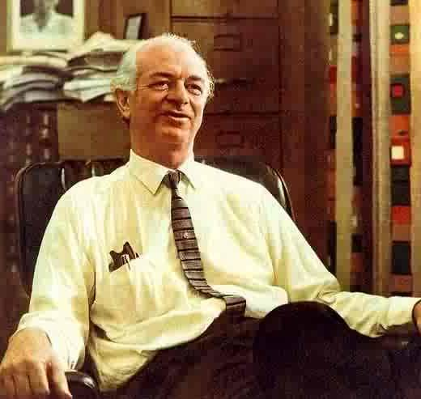
Electronegativity
The ability of an
atom in a compound
to attract shared
electrons to itself.
Linus Pauling
1901 - 1994
Notes:
The Pauling electronegativity scale
– Based on measurements of the strengths of covalent bonds between different elements
– Pauling arbitrarily set the electronegativity of fluorine at 4.0, thereby creating a scale in which all elements have values between 0 and 4.0
– Electronegativities increase diagonally from the lower left to the upper right of the periodic table; elements lying on diagonal lines running from the upper left to lower right tend to have comparable values
– Pauling’s method is limited by the fact that many elements do not form stable covalent compounds with other elements
– Pauling scale is based on the properties of atoms in molecules
LINUS PAULING A Biography
Linus Pauling was born with twin legacies. Although his parents could give him very little in the way of material wealth, they did give him the better gift of great intelligence. His brilliant mind eventually provided him with financial security as well as his greatest happiness. It can also be argued that this gift of intelligence was responsible for the controversy that seemed to surround everything he did and everything he wrote. He made great intuitive leaps and was frequently criticized for the conclusions he drew from what some felt was too little experimentation, often outside of Pauling's area of expertise. His father was part pharmacist and part "medicine man" and wasn't especially successful at either. At the time when Linus was born in 1901 the family was living in what is now the wealthiest suburb of Portland, Oregon. However, they lived a very precarious existence at the edges of poverty. In fact, when Linus was four, the family moved to his mother's home town of Condon to get financial aid from her family. Condon is a small town in north central Oregon and in many ways then (and now) was a stereotypical 'Western' town with one main street and false fronts on many of the business buildings. In Condon his father took over the town drug store and Linus began exploring the physical world around him. A small creek flows on the south edge of town. There he and a friend explored the rocky creek bed and collected some of the minerals for which Pauling would eventually establish structures at the California Institute of Technology . It was likely during this time in Condon that Pauling developed his antipathy to snow and very cold weather. Condon's altitude is about 4000 feet and during the winter the temperature may not go above -20 Fahrenheit for days at a time. The wind roars through town because the town sits on top of the Columbia Basalt plateau and for miles around there is nothing to deflect the winds.
The Pauling family moved back to Portland just after Linus began school. When he was nine, his father died, leaving Linus, his two younger sisters and their mother to make their own way in the world. This began a stretch of more than 15 years when Pauling tried to pursue his education, while his mother tried to get him to quit school and become the support of the family. He did not quit school. However, he did find many ingenious ways to make money and most of it went to help support his mother and sisters. By the time he was twelve he was a freshman at Washington High School in Portland. After four years of learning, with or without the help of his teachers, and of odd jobs (delivering milk, running film projectors, and even working in a shipyard, for example) he left high school. He did not graduate because the high school required their students to take a class in civics and Pauling saw no reason why he should since he could absorb any of that from his own reading. Later, after his Nobel Prize for Peace in 1962, the administration agreed that he had learned civics on his own by granting him his high school diploma. In the fall of 1917 Pauling enrolled in Oregon Agricultural College-now Oregon State University-in Corvallis, Oregon. He sailed through the freshman courses required of a chemical engineering major in spite of the fact that he was also working one hundred hours a month. He was not only supporting himself, but also providing the bulk of his family¹s support. This became more and more arduous after his mother became ill. In fact, he did not return to the college after his sophomore year because of the need for money. However, at the first of November of what would have been his junior year, he received an offer to become an instructor of quantitative analysis at Oregon Agricultural College, a course he had just taken as a sophomore! The offer included a salary of $100 a month and he gladly took it. He himself did not take any courses that year. He met his future wife, Ava Helen Miller, when she was a student in his quantitative analysis class.
When he had graduated with his degree in chemical engineering, his mother again began pressuring him to stop his education and make money, perhaps become a secondary school teacher. Pauling, however, had applied to graduate schools at Harvard, Berkeley and the fairly new California Institute of Technology. His first choice was Berkeley because G.N. Lewis himself was the chair of the chemistry department, but Berkeley was too slow in replying to his application. Harvard didn't really interest him much, so his decision was made in favor of Cal. Tech. One year after begining work at Cal. Tech. he married Ava Helen Miller.
At the California Institute of Technology his advisor was Roscoe Dickinson, whose area of expertise was X-ray crystallography. At this time Dickinson was investigating the crystal structure of various minerals. In his work with Dickinson, Pauling displayed what was to become his standard method of attacking a problem. According to Dr. Edward Hughes, "He would guess what the structure might be like, and then he would arrange it to fit into the other data. . . he could then calculate the intensities he would get from that structure and then compare it with the observed ones." For the rest of his career Pauling was criticized for using too large an amount of intuition in his work and not always having complete data to back up what he wrote. As well as doing his research work, Pauling was taking courses and serving as a teaching assistant in the freshman chemistry course. He received his Ph. D. in chemistry with high honors in the June of 1925. His dissertation comprized the various papers he had already published on the crystal structure of different minerals.
A year later, when he was 25, he received a Guggenheim fellowship to study at the University of Munich under Arnold Sommerfeld, a theoretical physicist. Here he began work with quantum mechanics. In January of 1927 he published "The Theoretical Prediction of the Physical Properties of Many Electron Atoms and Ions; Mole Refraction, Diamagnetic Susceptibility, and Extension in Space" in which he applied the concept of quantum mechanics to chemical bonding. In March, a heated exchange took place between Pauling and W.L. Bragg in London over this paper. Bragg believed that Pauling had used some of his ideas without giving him credit for them. According to Pauling, the ideas originated in a paper by Gregor Wentzel on quantum mechanical calculations for electrons in complex atoms. "Wentzel reported poor agreement between the calculated and experimental values, but I found that his calculation was incomplete and that when it was carried out correctly, it led to values... in good agreement with the experimental values." In 1928 he published six principles to decide the structure of complicated crystals. This bothered Bragg even more since they did not all originate with Pauling. Actually, according to Horach Judson, "Pauling clarified them, codified them, demonstrated their generality and power." However, Bragg was spreading stories in England about Pauling's "thievery" and lack of professional ethics.
At this time Pauling took an assistant professorship in chemistry at Cal. Tech. There was a discrepancy, however, in what he thought he was being offered and what he was actually given. He had thought he was taking an appointment as Assistant Professor of Theoretical Chemistry and Mathematical Physics. This misunderstanding seems to have been a thorn in his side. However, thorn or no thorn, he began a period of intense and productive work. In 1928 he published a paper on orbital hybridization and resonance. In 1931 he published the first paper, "The Nature of the Chemical Bond". At this time he was also teaching classes. One of his responsibilities was the freshman chemistry course. Richard Noyes, now professor emeritus of physical chemistry at the University of Oregon, remembers that Pauling was an exciting lecturer and had an unbelievable ability as a demonstrator. He would be explaining something and "suddenly his mind would go off in a new direction, frequently into areas where the freshmen couldn't follow him." Dr. Noyes remembers one redox titration when Pauling turned on the buret then stepped to the chalkboard and began to write the equation for the reaction. He was glancing at the flask in which the reaction was taking place and suddenly moved back to the buret and turned it off, then swirled the mixture in the flask. The color was perfect, a perfect endpoint!
In 1931 Pauling was awarded the Langmuir Prize of the American Chemical Society for "the most noteworthy work in pure science done by a man under 30 years of age." In the same year he was offered a joint full professorship in both chemistry and physics at the Massachusetts Institute Of Technology. He seriously considered the offer but he didn't want to have to brave the Massachusetts' winters. He ended up by accepting the position for one year only. In 1933 he was made a member of the National Academy of Sciences. He was 32, the youngest appointment to this body ever made.
Pauling was later to write, "By 1935, I had worked out most of the fundamental problems connected with the chemical bond." and "My serious interest in what is now called molecular biology began about 1935." He began with a look at hemoglobin. He discovered that the hemoglobin in arteries is repelled by a magnet while that in the veins is attracted to a magnet. His answer to this puzzle resulted in a paper on oxygen's binding to hemoglobin in 1936. The work on hemoglobin also lead to work on hydrogen-bonding between the polypeptide chains in proteins and another paper that same year on the denaturing of proteins. Also in 1936, he was made chairman of the Division of Chemistry and Chemical Engineering at Cal. Tech. In 1939 he published his most important book, The Nature of the Chemical Bond.
His work on hydrogen-bonding in proteins lead him to develop a theory of protein structure. It was generally accepted that proteins were made up of polypeptide chains which were, in turn, made up of long strings of amino acids, bonded end to end. He tried to demonstrate a way of coiling the polypeptide chain in the protein alpha keratin to match the x-rays that crystallographer W.T. Astbury had taken and interpreted, but was unable to fit a model to the data. Working with Corey, he did establish the structures of many small peptides and established that the peptide bond holding amino acids together is planar. In 1939 they formulated a small set of structural conditions for any model of a popypeptide chain.
Finally, in 1948, Pauling worked out the alpha helix structure of a polypeptide. He was in Oxford at this time, confined to bed with nephritis and bored with what he had to read. He says, "I took a sheet of paper and sketched the atoms with the bonds between them and then folded the paper to bend one bond at the right angle, what I thought it should be relative to the other, and kept doing this, making a helix, until I could form hydrogen bonds between one turn of the helix and the next turn of the helix, and it only took a few hours doing that to discover the alpha-helix." In 1954 Linus Pauling was given the Nobel Prize for Chemistry for his work on molecular structure, especially proteins.
During World War II Pauling worked on various "war" projects as did everyone at Cal. Tech. He chose not to work on the Manhattan Project, however. At the same time his wife was becoming more and more involved in socialist politics. They fought the internment of their Japanese-American gardener and, with the American Civil Liberties Union, the internment of all the Japanese-Americans. He was also becoming more and more worried about the atomic bomb and the radiation it produced. He became involved in the Scientists Movement, a more-or-less nation-wide group of scientists working for safe control of nuclear power. The Movement believed in ³the necessity for all nations to make every effort to cooperate now in setting up an international administration with police powers which can effectively control at least the means of nuclear warfare.² His wife was a member of the Women's International League for Peace and Freedom. In fact, at this time, she was probably more outspoken on the issues of human rights, peace and the banning of nuclear testing than Pauling was. In 1947 President Truman awarded him the presidential Medal of Merit for his work on crystal structure, the nature of the chemical bond, and his efforts to bring about world peace.
In November of 1950, he was subpoenaed to appear before the Senate Investigating Committee on Education of the State of California. He testified for over two hours, "mainly about my reasons for objecting to special loyalty oaths involving inquiry into political beliefs." He wrote the next day, "My own political beliefs are well known. I am not a Communist. I have never been a Communist. I have never been involved with the Communist Party. I am a Rooseveltian Democrat." However, he also believed that no governmental body had the right to ask him to answer those same questions under oath. This was during the early days of the McCarthy "witch hunts", which were stronger at the time in California than at most other places. His position upset some of the trustees and some professors at Cal .Tech., who tried to oust him.
This was just after Pauling, working with Corey, had used the idea gained from his paper model to work out the structure of many different protein molecules, all of which contained his alpha-helix. His proposed structure was not immediately accepted by the scientific world, however, especially by scientists in England. Therefore, in January of 1952, Pauling requested a passport to attend a meeting in England, specifically to defend his ideas. The passport was denied because granting it "would not be in the best interest of the United States." He applied again and wrote President Eisenhower, asking him to arrange the issuance of the passport since, "I am a loyal citizen of the United States. I have never been guilty of any unpatriotic or criminal act." The answer came back asking him to provide the State Department with some evidence supporting his claims. He sent a statement, made under oath, stating that he was not a communist, never had been a communist, and had never been involved with the Communist Party. The state department replied that his "anti-communist statements were not sufficiently strong" and again denied the passport on the very day he was supposed to leave for the conference. This pattern of Pauling requesting a passport to attend various conferences and the state department denying the application continued for a little over two years. During this time Einstein wrote a letter to the state department supporting Pauling's right to have a passport. He also wrote Pauling telling him, "It is very meritorious of you to fight for the right to travel."
In 1953 Pauling published his book, No More War. Again in April of 1954, when he requested a passport, he was denied it. On November 3 of that year, while he was giving a "routine lecture" on hemoglobin at Cornell University, he was called to the telephone to learn that he had just been awarded the Nobel Prize in Chemistry. His first worry was, would he be able to get a passport so he could accept the prize in person? He applied immediately and for weeks he heard nothing. In Washington there were strong voices opposing the granting of the passport. One senator asked, "Are you in the State Department allowing some group of people in some foreign country to determine which Americans get passports?" On November 27, however, barely two weeks before the ceremony in Sweden, his passport did arrive.
His years of being unable to get a passport did more than inconvenience him. In 1948 he was already working toward a description of the structure of DNA. By the early 1950's, Rosalind Franklin and others working at Kings College in London had taken some of the sharpest, most detailed photographs of DNA ever. These are what Watson and Crick used in their successful discovery of the DNA double helix. Had Pauling been able to attend the spring 1952 conference he would likely have seen these photographs and might have come to the same conclusion, before Watson and Crick. It is sure that his not seeing them contributed to his proposed structure which had the phosphate groups closely packed inside a single helix with the bases sticking out around the outside.
Pauling continued his political activism, particularly his protesting of atomic bomb testing. This culminated in a petition to the United Nations--signed by 11,021 scientists from around the world--calling for an immediate world-wide ban on nuclear testing. Because of this petition he was subpoenaed to appear before the U.S. Senate Internal Security Committee. The committee wanted him to give the names of the petitioning scientists. Under oath, he admitted that he, Barry Commoner, and Edward Condon had initiated the petition, but refused to give any more names. There was much applause from the gallery and, after a while, the committee backed down. Later, during the Kennedy Administration, after Kennedy had decided to go ahead with atmospheric nuclear testing, Pauling sent President Kennedy a telegram asking, ³Are you to give the orders that will cause you to go down in history as one of the most immoral men of all times and one of the greatest enemies of the human race?² Of course, this telegram raised quite a furor. However, the Kennedys still invited him to a White House dinner honoring Nobel Prize winners of the western hemisphere. On the day of the dinner, both Dr. and Mrs. Pauling took part in a demonstration in front of the White House, then left the picket line to go in to dinner. Later that evening, Pauling even danced with Mrs. Kennedy.
On October 10, 1962, it was announced that Linus Pauling had been awarded the Nobel Peace Prize for his efforts on behalf of a nuclear test ban treaty. This award was not universally popular. Many newspapers and magazines printed editorials denouncing him, his activism,and his having been given the prize.
Since his second Nobel Prize, Dr. Pauling has researched the chemistry of the brain and its effect on mental illness, the cause of sickle-cell anemia and what is happening to the hemoglobin in the red blood cells of people with this disease, and the effects of large doses of vitamin C on both the common cold and some kinds of cancer. He recently published papers on high temperature super conductivity. He has worked at the University of California at San Diego, at Stanford and at the Linus Pauling Institute for Medical Research. He has won many awards in chemistry, including all the major ones. He remains, as he has been all his life, a brilliant man with brilliant ideas. He was once asked by a high school student , "How can I have great ideas?" Pauling's answer was, "The important thing is to have many ideas." He has certainly followed his own advice.
References
1. A. Serafini, Linus Pauling A Man and His Science, Paragon House, New York, N.Y., 1991. 2. A.J. Ihde, The Development of Modern Chemistry, Dover, New York, N.Y., 1984, pp. 543 & 544, p 551.
3. J. H. Sturdivant, "The Scientific Work of Linus Pauling", A. Rich & N. Davidson, Structural Chemistry and Molecular Biology, W.H. Freeman and Co., San Francisco, CA, 1968, pp. 16, 18, 19.
4. D.C. Hodgkin & D.P. Riley, "Some Ancient History of Protein X-Ray Analysis", A.Rich and N. Davidson, Structural Chemistry and Molecular Biology, W.H. Freeman and Co., San Francisco, Ca.,1968, pp. 7, 8, 16, 18, 19.
5. "Pauling, Linus Carl", S.P. Parker, ed., McGraw-Hill Encyclopedia of Chemistry, Volume 9, McGraw-Hill, New York, N.Y., 1982, pp. 370 - 372.
http://www.woodrow.org/teachers/chemistry/institutes/1992/Pauling.html

Slide 31
Electronegativities
1A
8A
1
H
2.1
1
2A
3A
4A
5A
6A
7A
2
Li
1.0
Be
1.5
B
2.0
C
2.5
N
3.0
O
3.5
F
4.0
2
3
Na
0.9
Mg
1.2
Al
1.5
Si
1.8
P
2.1
S
2.5
Cl
3.0
3
3B
4B
5B
6B
7B
8B
1B
2B
Period
4
K
0.8
Ca
1.0
Sc
1.3
Ti
1.5
V
1.6
Cr
1.6
Mn
1.5
Fe
1.8
Co
1.8
Ni
1.8
Cu
1.9
Zn
1.7
Ga
1.6
Ge
1.8
As
2.0
Se
2.4
Br
2.8
4
5
Rb
0.8
Sr
1.0
Y
1.2
Zr
1.4
Nb
1.6
Mo
1.8
Tc
1.9
Ru
2.2
Rh
2.2
Pd
2.2
Ag
1.9
Cd
1.7
In
1.7
Sn
1.8
Sb
1.9
Te
2.1
I
2.5
5
Cs
0.7
Ba
0.9
∗
6
La
1.1
Hf
1.3
Ta
1.5
W
1.7
Re
1.9
Os
2.2
Ir
2.2
Pt
2.2
Au
2.4
Hg
1.9
Tl
1.8
Pb
1.8
Bi
1.9
Po
2.0
At
2.2
6
Fr
0.7
Ra
0.9
ψ
Ac
1.1
∗
7
Lanthanides: 1.1 - 1.3
ψ
Actinides: 1.3 - 1.5
Below 1.0
2.0 - 2.4
1.0 - 1.4
2.5 - 2.9
1.5 - 1.9
3.0 - 4.0
Hill, Petrucci, General Chemistry An Integrated Approach 2nd Edition, page 373
Notes:
Linus Pauling (1901 - 1994) awarded Nobel Prize in chemistry in 1954 for his 1939 text, The Nature of the Chemical Bond,
and also won the Nobel Peace Prize in 1962 for his fight to control nuclear weapons.
The greater the electronegativity of an atom in a molecule, the more strongly it attracts the electrons in a covalent bond.
• Elements with high electronegativities tend to acquire electrons in chemical reactions and are found in the upper-right corner of the periodic table.
• Elements with low electronegativities tend to lose electrons in chemical reactions and are found in the lower-left corner of the periodic table.

Slide 32
Ionization Energy

Slide 33
Ionization Energies
• Energy is required to remove an electron from an atom to form a cation.
• Ionization energy (Ι) is the amount of energy needed to remove an electron from the gaseous atom E in its ground state:
E _{(g)} + Ι → E⁺_{(g)} + e⁻⁻ energy required for reaction = Ι.
• Ionization energy is always positive (Ι > 0).
• Larger values of Ι mean that the electron is more tightly bound to the atom and is harder to remove.
• Units for ionization energies are kilojoules/mole (kJ/mol) or electron volts (eV) - 1 eV = 96.49 kJ/mol.
Copyright © 2007 Pearson Benjamin Cummings. All rights reserved.

Slide 34
First Ionization Energies (kJ/mol)
s
p
H
1312.1
He
2372.5
Li
520.3
Be
899.5
B
800.7
C
1086.5
N
1402.4
O
1314.0
F
1681.1
Ne
2080.8
Na
495.9
Mg
737.8
Al
577.6
Si
786.5
P
1011.8
S
999.7
Cl
1251.2
Ar
1520.6
K
418.9
Ca
589.9
Ga
578.6
Ge
761.2
As
946.5
Se
940.7
Br
1142.7
Kr
1350.8
Rb
402.9
Sr
549.2
In
558.2
Sn
708.4
Sb
833.8
Te
869.0
I
1008.7
Xe
1170.3
Smoot, Price, Smith, Chemistry A Modern Course 1987, page 188
Notes:
Metals have low ionization energy; nonmetals have high ionization energy.
This experimental data gives evidence for:
1) effect of increasing nuclear charge
2) stability of octet
3) effect of increased radius
4) s & p sublevel in outer level
SUGGESTION: Emphasize that theories came from experimental evidence!

Slide 35
First Ionization Energies (kJ/mol)
Metal
Metalloid
Nonmetal
s
p
H
1312.1
He
2372.5
Li
520.3
Be
899.5
B
800.7
C
1086.5
N
1402.4
O
1314.0
F
1681.1
Ne
2080.8
Na
495.9
Mg
737.8
Al
577.6
Si
786.5
P
1011.8
S
999.7
Cl
1251.2
Ar
1520.6
K
418.9
Ca
589.9
Ga
578.6
Ge
761.2
As
946.5
Se
940.7
Br
1142.7
Kr
1350.8
Rb
402.9
Sr
549.2
In
558.2
Sn
708.4
Sb
833.8
Te
869.0
I
1008.7
Xe
1170.3
Smoot, Price, Smith, Chemistry A Modern Course 1987, page 188
Notes:
Metals have low ionization energy; nonmetals have high ionization energy.
This experimental data gives evidence for:
1) effect of increasing nuclear charge
2) stability of octet
3) effect of increased radius
4) s & p sublevel in outer level
SUGGESTION: Emphasize that theories came from experimental evidence!
Note: Atoms do not lose d- or f-sublevel electrons.
Why? Only valence electrons (s- and p- orbitals) are removed. Kernel electrons (d- and f-orbitals) are not lost.

Slide 36
He
Helium (He) has…
a greater IE than H
same shielding
greater nuclear charge
n
H
First Ionization energy
1e⁻
2e⁻
1+
2+
H
He
Atomic number

Slide 37
He
Li has…
lower IE than H
more shielding
Further away outweighs greater nuclear charge
n
H
First Ionization energy
Li
Atomic number

Slide 38
He
Be has higher IE than Li
same shielding
greater nuclear charge
n
H
First Ionization energy
2e⁻
2e⁻
Be
3+
2e⁻
1e⁻
2e⁻
3+
1e⁻
4+
2e⁻
2e⁻
4+
Li
Be
Li
Atomic number

Slide 39
He
B has lower IE than Be
same shielding
greater nuclear charge
p-orbitals available
n
2e⁻
2e⁻
4+
2e⁻
2e⁻
3e⁻
4+
2e⁻
5+
2e⁻
3e⁻
H
5+
First Ionization energy
Be
Be
B
B
Li
2p
2s
1s
Atomic number

Slide 40
He
n
H
C
First Ionization energy
Be
B
Li
2p
2s
1s
Atomic number

Slide 41
He
n
N
H
C
First Ionization energy
Be
B
Li
2p
2s
1s
Atomic number

Slide 42
He
n
N
Breaks the pattern because
removing an electron
gets to ½ filled p-orbital
H
C
O
First Ionization energy
Be
B
Li
2p
2s
1s
Atomic number

Slide 43
He
n
F
N
H
C
O
First Ionization energy
Be
B
Li
2p
2s
1s
Atomic number

Slide 44
He
Ne
n
F
N
Ne has a lower IE than He
Both are full energy levels,
Ne has more shielding
Greater distance
H
C
O
First Ionization energy
Be
B
Li
2p
2s
1s
Atomic number

Slide 45
He
Ne
n
F
N
Na has a lower IE than Li
Both are s¹
Na has more shielding
Greater distance
H
C
O
First Ionization energy
Be
B
3s
Li
2p
2s
Na
1s
Atomic number

Slide 46
He
Be has higher IE than Li
same shielding
greater nuclear charge
n
H
First Ionization energy
2e⁻
2e⁻
Be
1e⁻
2e⁻
3+
4+
Li
Be
Li
Atomic number

Slide 47
He
B has lower IE than Be
same shielding
greater nuclear charge
p-orbitals available
n
2e⁻
2e⁻
2e⁻
3e⁻
H
4+
5+
First Ionization energy
Be
Be
B
B
Li
2p
2s
1s
Atomic number

Slide 48
He
Ne
Na has a lower IE than Li
Both are s¹
Na has more shielding
Greater distance
F
N
H
C
O
First Ionization energy
Be
B
Li
Na
Atomic number

Slide 49
He
Ne
Ar
Kr
H
First Ionization energy
Li
Na
K
Rb
Atomic number

Slide 50
Multiple Ionization Energies
Al
2745 kJ/mol
e⁻
578 kJ/mol
e⁻
Al⁺
1817 kJ/mol
e⁻
Al²⁺
Al³⁺
1st Ionization
energy
2nd Ionization
energy
3rd Ionization
energy
The second, third, and fourth ionization energies of aluminum are higher
than the first because the inner electrons are more tightly held by the nucleus.
Smoot, Price, Smith, Chemistry A Modern Course 1987, page 190
Notes:
• In an atom that possesses more than one electron, the amount of energy needed to remove successive electrons increases steadily.
• Define a first ionization energy as (Ι₁), a second ionization energy as (Ι₂) and in general an nth ionization energy (Ι_{n}) according to the equation
E_{(g)} → E⁺_{(g)} + e⁻⁻ Ι₁ = 1st ionization energy
E⁺_{(g)} → E²⁺_{(g)} + e⁻⁻ Ι₂ = 2nd ionization energy
E^{(n-1)+}_{(g)} → E^{n+}_{(g)} + e⁻⁻ Ι_{n} = nth ionization energy

Slide 51
Ionization Energies (kJ/mol)
Element
H
He
Li
Be
B
C
Al
1st
1312.1
2372.5
520.3
899.5
800.7
1086.5
577.6
2nd
5250.7
7298.5
1752.2
2427.2
2352.8
1816.7
3rd
11815.6
14849.5
3660.0
4620.7
2744.8
4th
21007.6
25027.0
6223.0
11577.5
5th
32828.3
37832.4
14831.0
6th
47279.4
18377.9
Smoot, Price, Smith, Chemistry A Modern Course 1987, page 190
Notes:
Ionization energy increases with the removal of each additional electron.
Metals have low ionization energy; nonmetals have high ionization energy.
This experimental data gives evidence for:
1) effect of increasing nuclear charge
2) stability of octet
3) effect of increased radius
4) s & p sublevel in outer level
SUGGESTION: Emphasize that theories came from experimental evidence!

Slide 52
Ionization Energies (kJ/mol)
Element
Na
Mg
Al
Si
P
S
Cl
Ar
1st
498
736
577
787
1063
1000
1255
1519
2nd
4560
1445
1815
1575
1890
2260
2295
2665
3rd
6910
7730
2740
3220
2905
3375
3850
3945
4th
9540
10,600
11,600
4350
4950
4565
5160
5770
5th
13,400
13,600
15,000
16,100
6270
6950
6560
7320
6th
16,600
18,000
18,310
19,800
21,200
8490
9360
8780
Herron, Frank, Sarquis, Sarquis, Cchrader, Kulka, Chemistry 1996, Heath, page
Shaded area on table denotes core electrons.
Notes:
Ionization energy increases with the removal of each additional electron.
Metals have low ionization energy; nonmetals have high ionization energy.
This experimental data gives evidence for:
1) effect of increasing nuclear charge
2) stability of octet
3) effect of increased radius
4) s & p sublevel in outer level
SUGGESTION: Emphasize that theories came from experimental evidence!

Slide 53
Ionization Energies (kJ/mol)
Element
Na
Mg
Al
Si
P
S
Cl
Ar
1st
498
736
577
787
1063
1000
1255
1519
2nd
4560
1445
1815
1575
1890
2260
2295
2665
3rd
6910
7730
2740
3220
2905
3375
3850
3945
4th
9540
10,600
11,600
4350
4950
4565
5160
5770
5th
13,400
13,600
15,000
16,100
6270
6950
6560
7320
6th
16,600
18,000
18,310
19,800
21,200
8490
9360
8780
Herron, Frank, Sarquis, Sarquis, Cchrader, Kulka, Chemistry 1996, Heath, page
Shaded area on table denotes core electrons.
Notes:
Ionization energy increases with the removal of each additional electron.
Metals have low ionization energy; nonmetals have high ionization energy.
This experimental data gives evidence for:
1) effect of increasing nuclear charge
2) stability of octet
3) effect of increased radius
4) s & p sublevel in outer level
SUGGESTION: Emphasize that theories came from experimental evidence!

Slide 54
Metallic Characteristics
metallic character increases
nonmetallic character increases
metallic character increases
nonmetallic character increases
Notes:
• Elements with the highest ionization energies are those with the most negative electron affinities, which are located in the upper-right corner of the periodic table.
• Elements with the lowest ionization energies are those with the least negative electron affinities and are located in the lower-left corner of the periodic table.
• The tendency of an element to gain or lose electrons is important in determining its chemistry.
• Various methods have been developed to describe this tendency quantitatively.
• The most important method is called electronegativity (χ), defined as the relative ability of an atom to attract electrons to itself in a chemical compound.

Slide 55
Summary of Periodic Trends
Shielding is constant
Atomic radius decreases
Ionization energy increases
Electronegativity increases
Nuclear charge increases
Nuclear charge increases
Shielding increases
Atomic radius increases
Ionic size increases
Ionization energy decreases
Electronegativity decreases
1A
0
2A
3A
4A
5A
6A
7A
Ionic size (cations) Ionic size (anions)
decreases decreases
Notes:
• Elements with the highest ionization energies are those with the most negative electron affinities, which are located in the upper-right corner of the periodic table.
• Elements with the lowest ionization energies are those with the least negative electron affinities and are located in the lower-left corner of the periodic table.
• The tendency of an element to gain or lose electrons is important in determining its chemistry.
• Various methods have been developed to describe this tendency quantitatively.
• The most important method is called electronegativity (χ), defined as the relative ability of an atom to attract electrons to itself in a chemical compound.
Rules for assigning oxidation states are based on the relative electronegativities of the elements — the more-electronegative element in a binary compound is assigned a negative oxidation state
Electronegativity values used to predict bond energies, bond polarities, and the kinds of reactions that compounds undergo
Trends in periodic properties:
1. Atomic radii decrease from lower left to upper right in the periodic table.
2. Ionization energies become more positive, electron affinities become more negative, and electronegativities increase from the lower left to the upper right.

Slide 56
Autobiography of an Element
I am Promethium, Pm for short. I was named after Prometheus, who
according to Greek mythology, brought fire to man. I'm a member of the
Lanthanide (rare earth) elements. My family name is derived from the Greek
lanthum, meaning “to escape notice”.
You may not have noticed me around before, as I have no naturally
occurring isotopes. True to family tradition, I managed to avoid positive
identification until 1965. O. Ermetsa first isolated 350 mg ¹⁴⁷Pm from 6000
tons apatite. Once discovered, I was immediately put to work. Large quantities
of ¹⁴⁷Pm salts (luminesce pale blue or green) are used in luminescent paint
for watch dials. Another job I've held is as a part in a beta-voltaic battery.
You may think there is not enough of me to go around. However, everyday,
my cousin ¹⁴⁷Sm transforms into Promethium by radioactive decay (at a rate of
0.07%/day). Also, I'm a rare earth fission product of uranium. Please get to
know me. I'll be around for awhile with ¹⁴⁷Pm half-life of 2.5 years and ¹⁴⁵Pm
half-life of 30 years.

